Slide 1
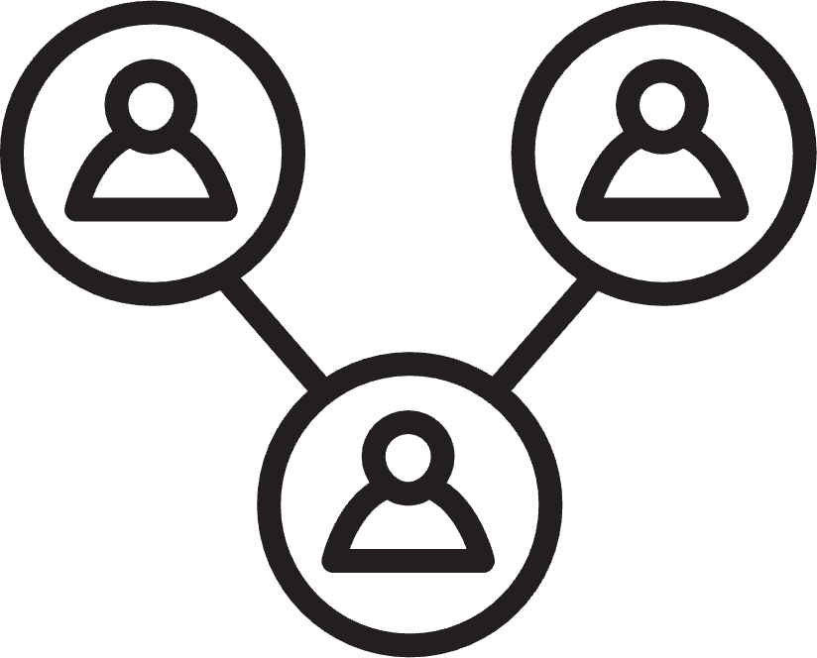
Student Mental Health
The [insert entity name] is committed to support the mental health of our students. This poster will support that through identifying approaches and sharing resources with the community.
01
BEHAVIORS
Common behaviors of individuals struggling with mental health or those in a mental health crisis may include: avoidance, isolation, substance abuse, withdrawal, negative self-talk, rumination, perfectionism, overworking, self-harm, or sleep issues.
RESOURCES
02
INSERT - A list of, and contact information for, school site-specific resources, including, but not limited to, counselors, wellness centers, and peer counselors.
03
CONTACTS
INSERT - A list of, and contact information for, community resources, including, but not limited to, suicide prevention, substance abuse, child crisis, nonpolice mental health hotlines, public behavioral health services, and community mental health centers.
POSITIVE COPING SKILLS
04
Positive coping strategies to use when supporting mental health include self-care (physical and mental), seeking support, meditation, breathing, mindfulness, positive thinking, setting boundaries, gratitude activities, hobbies, stress management and physical activity such as yoga.
05
NEGATIVE COPING STRATEGIES
A list of negative coping strategies to avoid, include, but not limited to, substance abuse or self-medication, violence and abuse, self-harm, compulsivity, dissociation, catastrophizing, or isolating.
School/District/County Information
In accordance with AB 748 and Ed. Code 49428.5
Template provided by the
California Association of School Psychologists

Slide 2
AB 748
FOR DISTRICT/COUNTY USE…
This poster is required by AB 748 at the start of the 2023-24 school year and should prominently and conspicuously displayed in appropriate public areas that are accessible to, and commonly frequented by, pupils at each school site. The poster should also be distributed through social media, internet websites, portals, and learning platforms. The poster needs to be 8.5x11 with 12pt font and presented in English and primary languages that represent 15% of the population being served.
The areas in the poster should be adapted to each individual county/district/school. This template is provided as a courtesy by the California Association of School Psychologists and should be changed/reviewed by each educational entity.
Districts/Counties should edit this information to fit their district needs, resources, and contacts.
For more information about the bill AB 748

