Slide 1
Pupil Personnel Services Guidance for Checking-in on Students and Providing Counseling During School Closures
Susan K. Coats, Ed.D., School Psychologist, LEP #2836
Chair, CASP Mental Health Committee
Tom Sopp, MA, School Psychologist, LMFT #36146
Chair, CASP Advocacy & Leadership Committee
May 6, 2020
Notes:
Good afternoon, I am Dr. Susan Coats, the Chair on Mental Health and Crisis Consultation for the California Association of School Psychologists (CASP) and Tom Sopp is the CASP Chair for the Advocacy and Leadership Committee.
This is an unprecedented time in our national and world history. We all need to respond and work collaboratively to take care of ourselves, and support the needs of our students, families, staff, and communities. We believe we will get through this crisis with new medical and mental health insights, and inspiring stories of dedication, heroism, and resilience. We would like to thank you as school mental health professionals and educators for your service to our California communities during this difficult time.
For most of us, it has been 7 weeks since schools closed on our campuses and only a few weeks of schools virtually opening online. This transition has been arduous, trying to care for ourselves and our loved ones, and reaching out to our students. You’ve probably been stretched by learning new and unfamiliar technology, managing your professional work virtually, re-structuring your days with new health and household practices, and for many, becoming your child’s classroom aide.
It has already shown us gaps in laws, educational programs, and inequity in resources.
We would like to encourage you in this process, remind you to take care of yourselves, be patient and forgiving of errors, and to allow yourself to reset and adapt to this new normal for however long it last.
When Tom and I discussed what we thought you might need during this historical event, we wanted the materials to be practical, meaningful, and relevant.
This presentation is meant not only for Pupil Personnel Services (PPS) professionals, but also for the supervisors of PPS staff, and other school mental health professionals on how to support all students during the global pandemic using a “check-in” model, but also provide you telehealth guidance for those students who may need more long term, virtual counseling support. Please refer to our documents in the resource folder for more information, details, and hyperlinks to other resources.
We would like to get to know more about you and how CASP may further support you professionally by asking you a few short questions during our presentation.
POLL 1
The Pupil Personnel Services Guidance Document for Checking-In on Students During School Closures,
The Technology Checklist for School Telehealth Services, and the
The NASP PREPaRE Model, Crisis Intervention, and Global Pandemic infographic.
CDC HIPAA FERPA chart
Telehealth Tips: Managing Suicidal Clients During the COVID-19 Pandemic
Mental Health America’s Creating Healthy Routines
I would recommend that you download these documents, if you haven’t already, and refer to them during our presentation.

Slide 2
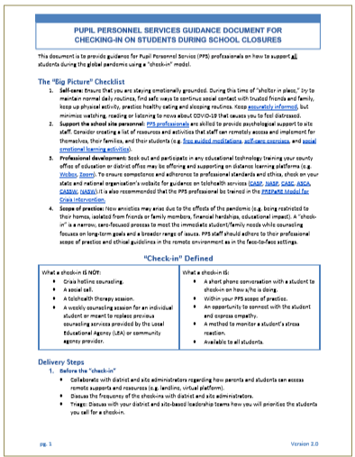
The “Big Picture” Checklist:
Self-care
Ensure that you are staying emotionally grounded. Try to maintain normal daily routines, find safe ways to continue social contact with trusted friends and family, keep up physical activity, practice healthy eating and sleeping routines. Keep accurately informed, but minimize watching the news.
Support the school site personnel
Create a list of resources and activities that staff can remotely access and implement for themselves, their families, and their students.
Professional development
Participate in any educational technology training your county office of education or district office may be offering, and follow their guidelines.
Scope of practice
PPS professionals should adhere to their professional scope of practice and ethical guidelines in the remote environment as in the face-to-face settings.
Notes:
Thank you Susan. Let’s start with the big picture. All of us started this school year just as if it run like any other school year and so it hummed along. I am a school psychologist assigned to the district’s Family Resources Centers, where teams of school counselors and school psychologist provide individual and group counseling services to students and connect families to community resources. The current pandemic has created a global crisis that has resulted is school closures. My district has been closed for almost 4 weeks. In an effort to support students in response to the closures, the FRC staff has been conducting “check-ins” with students for the last 2 weeks. I want to give a shout to my valued FRC colleagues, I am very fortunate to work with such a dedicated and highly skilled team.
Because I have 20 minutes to present on the “Check-in” model, I will provide broad strokes on the topic, the details are in your Guidance document located in your resource folder. We describe this as a Guidance document, which means to us that it is a starting point. We encourage you to make adaptations to fit your district’s resources, your community’s resources, and your students’ needs.
The presentation is designed to be linear: starting with the big picture, then examine considerations to discuss before, during and after conducting a check-in.
The Big picture starts with…
Own self-care. Because you are the best intervention tool, make sure you are grounded. The CASP Ethical Guidelines was update this year, School psychologists continually monitor their own psychological functioning to ensure they are working effectively with clients. Develop a stress management plan.
2. Support your teachers: Many have talked about the challenges of teaching without a pandemic, imagine with a pandemic and re-tooling yourself to a virtual classroom. Providing self care resources and talking with individual teachers about there transition, communicates that their work continues to matter. Consider showing appreciation to your school sites teachers for their work to build the plane while flying it.
4. Scope of practice
Due to the effects of the pandemic, families are experiencing anxiety from being restricted to their homes, isolated from friends or family members, financial hardships, educational impact, grief over the loss of traditional promotion and graduation activities. Supporting students and families in a crisis, is within your scope of practice. This is what you are trained for. I encourage you to rely on your training, stay within your scope of practice, follow ethical and legal guidelines and mandates while working in a remote environment as if the face-to-face settings.

Slide 3
Support the school site personnel:
Notes:
2. Support your teachers: Many have talked about the challenges of teaching without a pandemic, imagine with a pandemic and re-tooling yourself for a virtual classroom. Providing self care resources and talking with individual teachers about there transition, communicates that their work continues to matter. Consider showing appreciation to your school sites teachers for their work of building the plane while flying it.
At the beginning of this school year, my district’s focus has been self care. Since the beginning of the school year, the FRC staff have provided a self-care calendar and Staff PD on self-care.

Slide 4
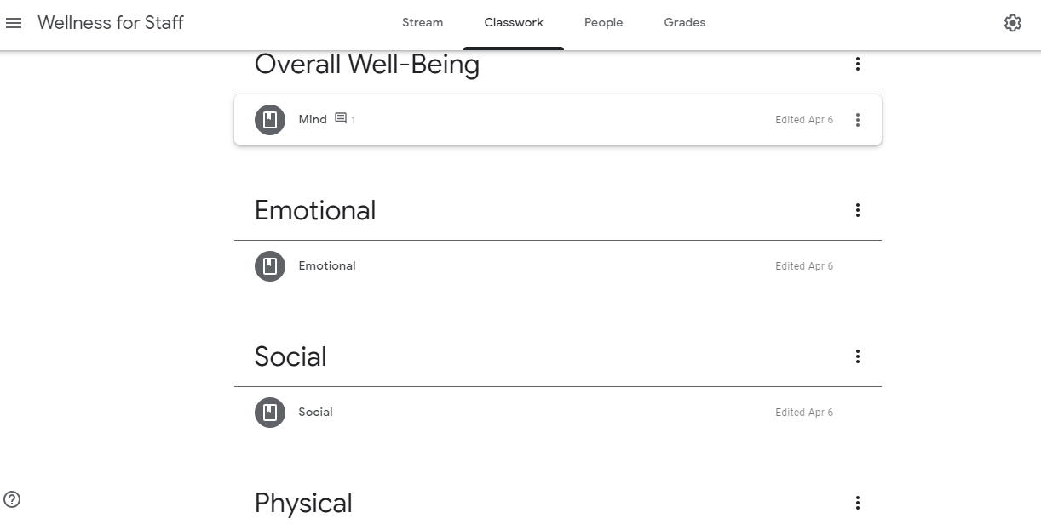
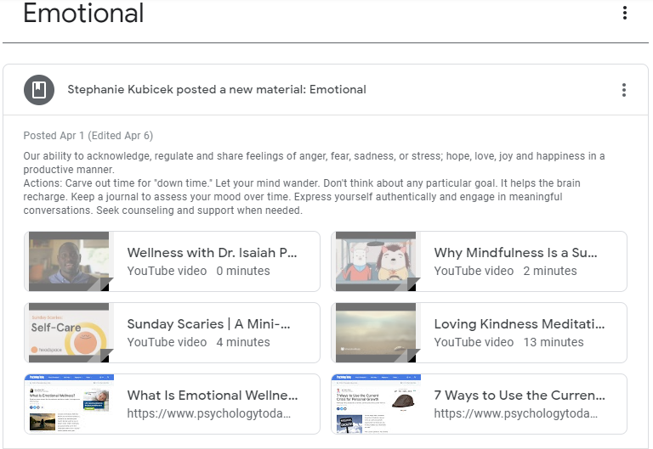
Support for site personnel:
Notes:
Consider creating a list of resources and activities that staff can remotely access and implement for their own self care., resources such as guided meditations, self-care exercises, and social emotional learning activities. The FRC has created a google classroom that staff can remotely access to search for self-care resources. We have received a lot of positive feedback

Slide 5
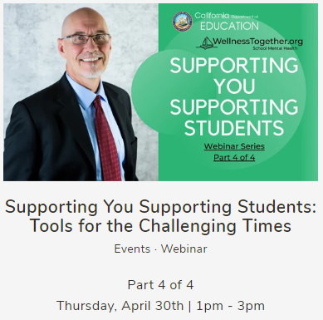
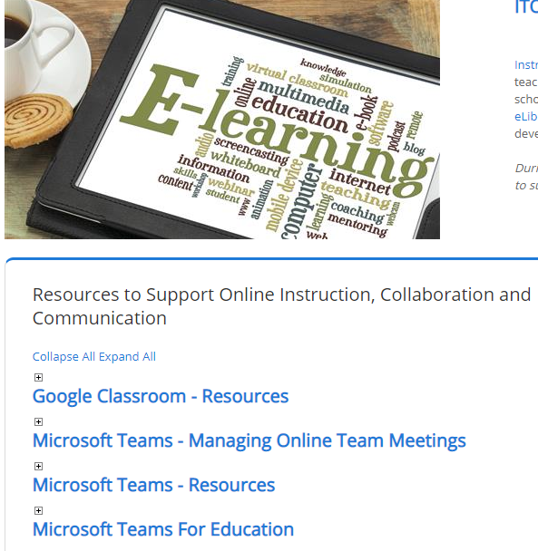
Professional development
https://www.wellnesstogether.org/blogs/news/tagged/events
https://www.lacoe.edu/Technology/Technology-Learning-Support-Services/ITO-Training-Resources
Notes:
3. Professional development
I recommend that you work with district and site based leaders to create a uniform model for conducting check-in. With the new model consider provide training on the model to ensure delivery at a high standard. Many PPS personnel are already trained in the PREPaRE Model for crisis intervention, which will be a helpful resource. Dr. Brock, one of the lead authors for PREPaRE recently reviewed the model specific for the Pandemic. You can access the recorded webinar at the website listed on the slide.
Technology training opportunities. Check your County Office of Education.

Slide 6
Scope of Practice:
School-based mental health services provider:...counselor, school psychologist, school social worker,...
(Every Child Succeeds Act (ESSA), Section 4102 Definitions (6) of Title IV).
California Teacher Credentialing PPS Training Standards:
School Counselors: Standard 25 Individual Counseling
…skilled in identifying the mental health needs of pupils (p. 48).
School Psychologists: Standard 21 Wellness Promotion, Crisis Intervention, and Counseling
...develop and implement mental health interventions (p. 72).
School Social Workers: Standard 20 Direct Learning Support Services
...basic methods of social work intervention, which may include counseling, crisis intervention, casework, group work, community organizing consultation, case management, family therapy, and effective educational strategies (p. 92).
(Pupil Personnel Services School Counseling, School Psychology, School Social Work, and Child Welfare and Attendance Program Standards Commission on Teacher Credentialing, October 2000).
Notes:
Ethically minded PPS professionals may ask this: Is a telephone check-in or telehealth services within my scope of practice? According to the Every Student Succeeds Act, school psychologists are school-based mental health services providers. The Commission on Teacher Credentialing, which oversees the PPS training standards, lists a counseling standard for school counselors, school psychologist, and school social workers. Remote access, whether it is through a telephone or through the internet, is a format for providing the mental health services we are trained to provide. There isn’t a certification or a separate license you need to show that you are competent to make a phone call or provide telehealth services. Telehealth is neither a treatment nor an intervention but how the student accesses the service.

Slide 7
“Check-in” Defined:
A “check-in” is a narrow, care-focused process to meet the immediate student/family needs while counseling focuses on long-term goals and a broader range of issues.
What a check-in IS NOT:
What a check-in IS:
Crisis hotline counseling.
A social call.
A telehealth therapy session.
A weekly counseling session for an individual student or meant to replace previous counseling services provided by the Local Educational Agency (LEA) or community agency provider.
A short phone conversation with a student to check-in on how s/he is doing.
Within your PPS scope of practice.
An opportunity to connect with the student and express empathy.
A method to monitor a student’s stress reaction.
Available to all students.
Notes:
Not 24/7 crisis hotline. I encourage you to set good boundaries just as if you were on campus.

Slide 8
“Check-in” Delivery Steps:
Before
Collaborate with district and site administrators regarding how parents and students can access remote supports and resources (e.g. landline, virtual platform).
If you are working from home, find a quiet and confidential location.
To keep your personal number private, create a free Google Voice phone number.
Make a list of hotline numbers, district supports, and community resources, including crisis contacts regarding suicide risk protocols during remote contacts.
Take steps to maintain confidentiality if at home.
Have resources available including hotlines, psychiatric mobile response team, district support, community supports.
Coats, S.K., Sopp, T.J. (2020). Pupil personnel services guidance document for checking-in on students during school closures. Endorsed by the California Association of School Psychologists Executive Committee, April 2020.
Notes:
Before conducting “check-ins”: There are preparation steps to consider. While I review these considerations, think about what district and site based leaders you need to meet with to make decisions and gather resources.
Platform. e.g. landline, cell phone, virtual platform, email, postcard, etc.
Discuss the frequency of the check-ins.
Ensure client confidentiality and security of the communications medium. If you relay on your personal cell phone, consider creating a free Google Voice phone number to keep your personal number private. If you are working from home with your family present, keeping conversations confidential may include closing the door, putting a sign up, lock the door, using ear buds.
Creating a list of hotline numbers, district supports, and community resources (e.g. food pantry, housing, health, employment, etc.). For example, in my contacts with parents who are not working, I been supplying food pantry information. You will probably do the same.
Before the situation arises, create a response protocol for working with a student who is significantly stressed, and for managing at-risk situations, such as suicidality. Review the district’s suicide assessment form and protocol to determine if it needs to modified for a remote access scenario. In the last two weeks, we have conducted two suicide assessments. Feedback from one assessor is be prepared to conduct the assessment without the visual cues of a face-to-face assessment.
Have with you the paper forms, and list of relevant mental health resources, including local emergency services such as the Department of Mental Health Psychiatric Mobile Response Team (PMRT), in the student’s geographical area.

Slide 9
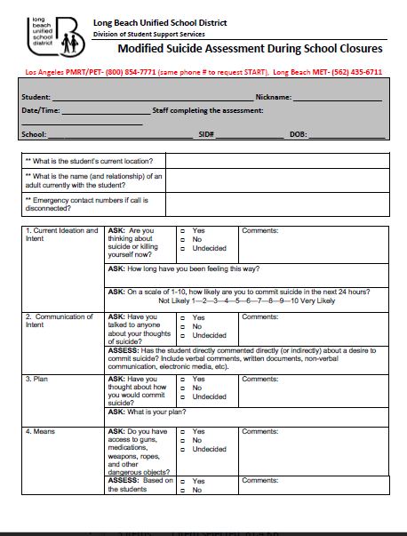
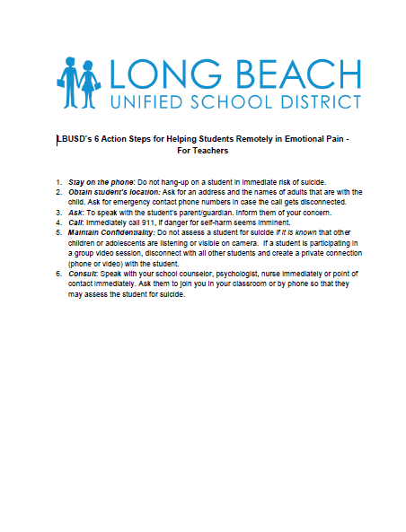
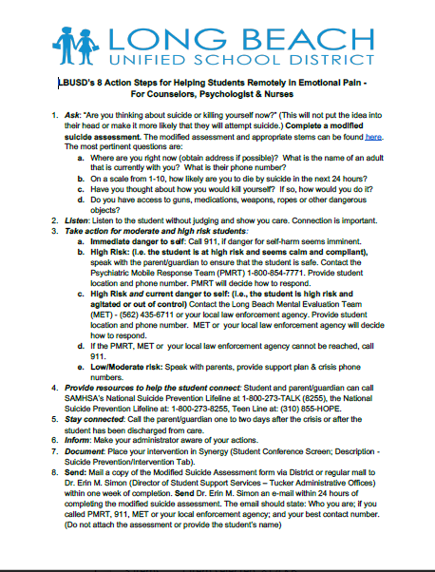
Plan for At-Risk Situations
Child Abuse: Remind personnel of child abuse reporting mandate applies to virtual platforms.
Check your LEA’s policies and procedures regarding suicide risk assessment protocols during remote contacts. If they do not have a protocol for this unique situation, offer to work with your supervisor on developing a safety protocol.
Student’s location and address
Adults with the student
Protocol for teachers and PPS providers
Resources ready to go
Notes:
The format does not change a professionals ethical and legal mandates. Ie,. suspected child abuse.
Cyber bullying is another issue. Teachers may need to be reminded or informed how to respond to bullying on a virtual platform. It didn’t take long but I know of teacher…

Slide 10
Triage Discuss with your district and site leadership teams what staff available and how you will triage students for Check-in.
Examples of triage considerations for students:
He/she is currently receiving mental health services and/or experienced an involuntary hospitalization this school year.
You know the student is living in an unstable home, has an open DCFS case, or is identified as a foster or homeless youth.
The student has a 504 Plan or IEP, and especially if he/she is receiving DIS Counseling services.
If the student is not capable to participate in a check-in due to his/her developmental level, cognitive ability, verbal skills, and psychosocial situation, consider an alternative manner to check-in such a parent/guardian phone call.
Notes:
Your team may want to discuss who will conduct the check-ins and how are you going triage your students for check-ins.
Listed on the slide and your guidance document, are examples of groups of students you may place at a high priority to reach out to first.
Determine whether the student is capable to participate in a check-in. Alternative ways to connect.

Slide 11
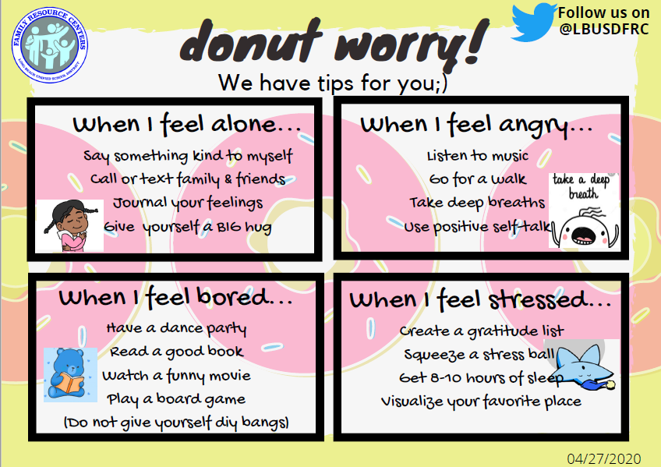
Alternative:
Notes:
The FRC created postcards as another means of reaching out.

Slide 12
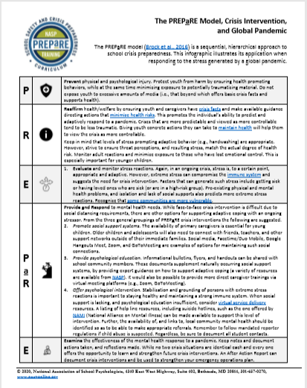
“Check-in” Delivery Steps:
During
Call parent/guardian. Share the purpose of the call, limits of confidentiality, the location of student and offer the family resources if needed.
Call student for “check-in”. Obtain verbal consent from the student, confirm student’s location at time of check-in and phone number. Ask the student about his/her daily routine, distal learning experience, and the effects of social distancing. End the conversation with hope and reassurance: We are all in this together. We will take this one day at a time.
What if the call becomes a longer conversation due to the…
Student experiencing significant stress.
Student is at risk.
The PREPaRE Model, Crisis Intervention, and Global Pandemic Infographic, (Brock et al., 2016).
Notes:
During the “check-in”:
Parent
Share the purpose of the call and build rapport. Example prompt: Hello, this is ____ , the school counselor/school psychologist/school social worker from ___school. May I please speak to the guardian/parent of____? I am calling to check in on your son/daughter. How are things going at home during this unusual time?
Student
If you have a preexisting relationship with this student, you will be sharing that you can only support them on-line, for now. This might be a difficult conversation. Example prompt: I know this is difficult and isn’t exactly how we usually share in person, but we can still talk on the phone or through a virtual platform. We will get through this together.
If a distal learning option has been initiated by the district, ask the student about his/her learning experience. If needed, provide district information on remote learning opportunities.
Ask the student about his/her daily routine. Example prompts: How are things going with your distal learning opportunities? How are the assignments? How are you managing your time during the day?
Ask about the student’s social support systems. Example prompts: How has social distancing affected you? How are you staying connected with your friends from school? Extended family members? Teachers? Spiritual congregation?
Ask them if they need you to check in on them periodically. How often? Best way to contact them.
Encourage them to ask questions, share their feelings, and remind them how brave and courageous they are during this difficult time.
NOTE: If student is significantly stressed, consider using the PREPaRE model, Crisis Intervention, and Global Pandemic as a guide.
Check your LEA’s policies and procedures regarding suicide risk assessment protocols during remote contacts. If they do not have a protocol for this unique situation, offer to work with your supervisor on developing a safety protocol. Post hotlines numbers, such as the National Suicide Prevention Lifeline 1-800-273-TALK, the California Peer-Run Warm Line 1-855-845-7415, the TrevorLifeline 1-866-488-7386, and local mental health agencies phone numbers for telehealth services on the district and school websites.
If the student states suicidal ideation, immediately contact the parent/guardian regarding the location of the student, your concern, and notify your supervisor for further support. Call 911 if emergency!

Slide 13
“Check-in” Delivery Steps:
After
Log the date and the time spent with the student. Make note of any concerns or resources needed for the student, and follow up with providing those resources.
If needed, collaborate with/support the parent/guardian regarding community support resources.
Determine if there is a need for a follow-up “check-in”, enrollment in a social/academic instructional group, or a referral for telehealth sessions. How often?
Notes:
After the “check-in”:
Document that the check-in occurred in the appropriate confidential area of your LEA’s Student Information System. Log the date and the time spent with the student. Make note of any concerns or resources needed for the student, and follow up with providing those resources.
If needed, collaborate with/support the parent/guardian regarding community support resources.
Determine if there is a need for a follow-up “check-in”, enrollment in a social/academic instructional group, or a referral for telehealth sessions.

Slide 14
Transition
Are you doing enough to take care of yourself?
What students would you prioritize for “check-in”?
How will you adaptive these documents to meet the needs of your students?
What resources do you need to gather?
What are your next steps?
Notes:
Let’s now transition to your LEA. Here are some questions to process:
In closing, the big picture is this school year has taken a sudden left turn. Collaborate with your colleagues to create plan that works for your students. Through my work with CASP, I have opportunity to talk with school psychologists across the state, I know how hard you are working to support your students during school closure. Because I appreciate your hard work so much, I wanted to give you something before I go. Some people find comfort in animals. Some are dog people, and some are cat people. But I think it is safe to say that everyone can find comfort from a baby bunnies.
Transition: Now that we know that school closures will continue for the remainder of the school year, many districts are looking ahead, researching telehealth options to provide counseling services. Dr. Coats will now introduce a checklist of considerations when establishing telehealth options.
We would like to have you answer our 2nd poll.

Slide 15
Telehealth
“…the use of electronic information and telecommunication technologies to support long-distance clinical health care, patient and professional health-related education, public health, and health administration. Technologies include video conferencing, the internet, store-and-forward imaging, streaming media, and terrestrial and wireless communications.” Health Resources and Services Administration (HRSA)
Telehealth or teletherapy, is where the clinician and the client are physically located in two different locations, and virtual services are provided remotely using technology via the Internet. National Association of School Psychologists (NASP)
Minor confidentiality rights and restrictions.
Parent/student consent forms needed for on-going counseling services not check-ins.
HIPAA vs FERPA & LEA technology platforms.
Health Resources and Services Administration (HRSA) https://www.hrsa.gov/rural-health/telehealth
National Association of School Psychologists. (2017). Guidance for delivery of school psychological telehealth [Brief]. Bethesda, MD: National Association of School Psychologists.
Notes:
Thank you Tom.
Please take out the School Telehealth Services Checklist for the next few slides. It will provide more detail as we move from a quick Check-In model to a more long term, virtual counseling approach.
The Health Resources and Services Administration of the US Department of Health and Human Services defines Telehealth as ….
The National Association of School Psychologists defines telehealth or teletherapy….. (read slide)
Minor confidentiality rights and restrictions are the same in the remote setting as in the face to face setting. You must get a parent or guardian’s permission for youth to receive on-going counseling support, and if the student is 12 years and older, the youth’s permission also. Restrictions to confidentiality rights refers to mandated child abuse reporting laws, and intervening in the event if the minor reveals a threat to themselves or others.
Informed consent forms are not required for virtual “check-ins”, but are required for on-going counseling services.
HIPAA or The Health Insurance Portability Accountability Act, ensures that healthcare providers implement multiple safeguards to protect sensitive personal and health information. Simply put, HIPPA protects both the private medical/mental health provider and the client’s medical and mental health records with integrity, confidentiality, and availability.
FERPA or the Federal Education Rights and Privacy Act, is a federal law that protects the privacy of student education records. This law applies to all schools that receive funds under the U.S. Department of Education. Elementary and secondary schools are protected under FERPA. Mental health professionals that are employed or covered by a school district are covered under FERPA, not HIPAA.
Local Educational Agencies that receive federal funds are not covered by HIPAA, but under FERPA, so it is important that the technology platform used during telehealth services for students be FERPA compliant. You’ve probably heard of some of these platforms such as Zoom, Webex, and TEAMS, just to mention a few. Each LEA has had to research, adopt, implement, and train staff on these platforms. Not a small task and in only a few weeks.
This next slide from the Center for Disease Control, contrasts the similarities and differences between HIPAA and FERPA. I have included a copy of this infographic in our handouts.
School-Based Health Center (SBHC)
HIPAA Applies If: The U.S. Department of Education has said that the records of a SBHC are not subject to FERPA “if the center is funded, administered and operated by or on behalf of a public or private health, social services, or other non-educational agency or individual….”3 “In these circumstances, the records are not ‘education records’ subject to FERPA, even if the services are provided on school grounds, because the party creating and maintaining the records is not acting on behalf of the school.”4 The records of a school based health center (SBHC) would be subject to HIPAA in these cases as long as the SBHC engages in any HIPAA covered transactions

Slide 16
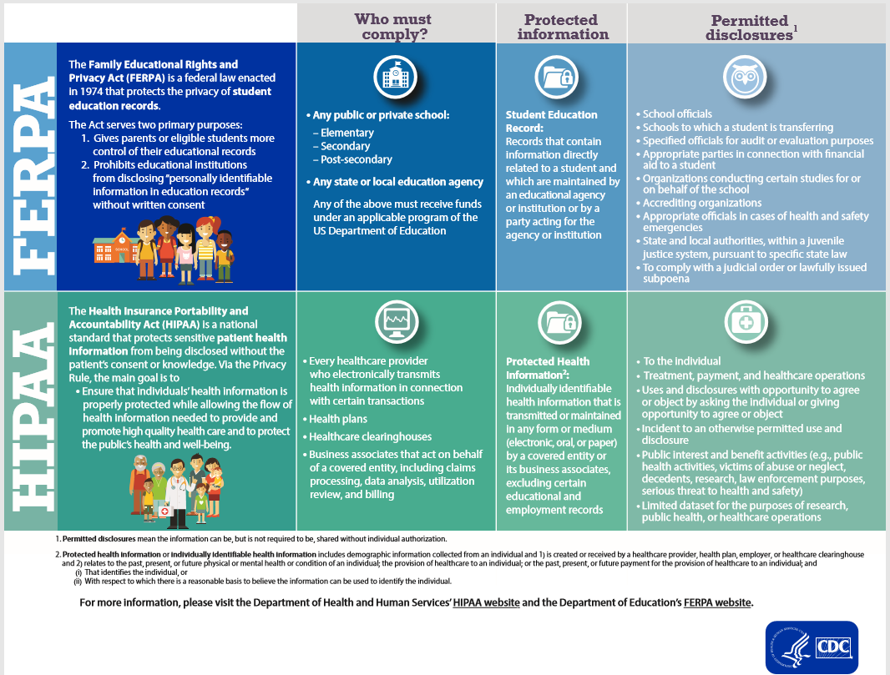
Notes:
This infographic summarizes the laws, who must comply, what information it protects, and permitted disclosures.

Slide 17
Terms and legal protection differences
HIPAA
FERPA
Telehealth
Licensed (Board of Behavioral Sciences)
Private practice contractor
Dept of Health Care Services (MediCal billing)
Defines telehealth, providers, services, types of communications, protections
Caregiver informed consent for youth
16 CCR § 1815.5§ 1815.5. Standards of Practice for Telehealth
Examples. Virtual/Remote Counseling, Psycho-educational Counseling……
CTC Credentialed
Licensed staff employed by LEA
Dept of Health Care Services (MediCal billing for IDEA students)
Caregiver informed consent for youth
Federal law, U.S. Department of Education, protects student educational records
AB 2315 (Quirk-Silva) 2018: CA Educ Code § 49429 (2019) NOT FUNDED… The Children’s Partnership state budget request 2020-2021
Notes:
Here is another short summary of the terms used and legal protections for staff and students.
Remember, FERPA is a federal law that protects the privacy of student education records. Staff employed by schools who receive federal funding are held to FERPA.
HIPAA protects both the private medical/mental health provider and patient/client. Licensed medical and mental health staff employed by private schools, medical clinics, and mental health agencies are held to HIPAA.
Under HIPAA (read slide)
Under FERPA (read slide)

Slide 18
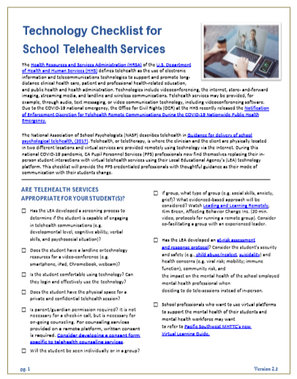
Checklist for School Telehealth Services
Are Telehealth services appropriate for your student(s)?
Student(s) capable of engaging in telehealth (e.g. developmental level, cognitive ability, verbal skills, and psychosocial situation)?
Does the student have a landline or technology resources for a video-conference?
Does the student have the physical space for a private and confidential session?
Will the student be seen individually or in a group? If group, what kind? Watch Kim Breen’s video “Leading and Learning Remotely” for running a remote group.
Technology
Is your LEA supportive of telehealth? Landline or virtual?
Does your LEA offer trainings on the technology platform? Do you feel confident using that platform?
Is the LEA’s technology platform FERPA compliant? HIPAA compliant if appropriate?
Does your student know how to login and use the technology? Be prepared to teach and review the appropriate technology involved in the session/group.
Coats, S.K., Sopp, T.J. (2020). Technology checklist for school telehealth services. Endorsed by the California Association of School Psychologists Executive Committee, April 2020.
Notes:
During this national pandemic, PPS professionals now find themselves replacing their in-person student interactions with virtual telehealth services using their LEA’s technology platform.
This checklist is meant to provide the PPS staff, and their supervisors, with thoughtful guidance as their mode of communication with students change. This list is not meant to be exhaustive and will rely on your LEA’s guidance.
First of all, ask yourself, is telehealth services appropriate for your student?
Is your student capable of engaging in telehealth communications considering their developmental level, cognitive ability, and verbal skills. For example, if a student has a verbal disability, you may need to collaborate with the parents or other adult family members while working with the youth.
Some students may have a landline or cell phone, but not a computer device. Many districts have free internet resources for students and are lending out Ipads or Chromebooks to students who don’t have computers at home so they can engage in distal learning. Internet quality and device availability will guide your mode of communication.
Does the student have the physical space for a private conversation? It could be very difficult during sheltering in place with other family members.
I don’t know about you, but I didn’t realize how much I depend on the environmental setting and in the presence of the student to give the counseling situation context. Kim Breen was a school counselor and then a school psychologist before becoming a national PBIS and MTSS presenter, and has been using the virtual platform for years. Using her vast experience, she created a 20” video to help you transition to the virtual setting.
What about your technology?
Is your district supportive of telehealth? On what type of device?
Do they provide trainings on the technology or the internet platform. We’ve all been on learning curve over the last 2 months on internet platforms. Most LEAs want you to use the same platform that teachers are using for remote learning.
Is the technology platform FERPA compliant?
Or are you a licensed mental health professional working in a school clinic providing contracted services? You may be working under HIPAA laws.

Slide 19
Checklist for School Telehealth Services
Office
To improve eye contact, position your device's camera so that it’s easy to look at the camera and the student on screen. Remove distractions in the background.
Make sure the room is well lit with the light in front of you so your face isn’t shadowed.
Pre-session
Check-in? If on-going counseling…get informed consent with a telehealth comment.
Does the LEA have a remote crisis plan? Hotline numbers, district supports, and resources (e.g. foodbanks, mental health agencies, DMH Psychiatric Mobile Response Team).
Are you using a Google number or an email to contact you if needed?
Initial session
Confirm student’s location and phone number.
Review importance of privacy, confidentiality, and security.
Be authentic and professional.
Notes:
Be comfortable with your office set-up. It takes some time to know how to use your camera, the lighting, and finding privacy in your home. The same for the student.
Before your interaction with the student, consider if this is going to be just a quick check-in, individual or group counseling.
Remember, a check in doesn’t require informed consent, but telehealth services suggests on-going counseling services and that requires parental consent. Consider adding some comments about the telehealth format on your existing informed consent form.
Just as Tom mentioned, it’s extremely important to know your district’s remote crisis plan in the case of a student emergency. Have your resources ready, hotline numbers, agency and clinic numbers, your district’s staff names, emails, and phone numbers if they handle certain student and family supports.
Do you need to set up a Google phone number, use *67, or does the LEA provide another way to communicate with your student and his/her family? Privacy is important for you and your student.
In your first session with the student, confirm his/her location and phone number. Just like in Tom’s example, the student may be in a different location during the day than the parent. You need to know who they are with and where they are in the case of an emergency. Have the student’s other emergency contact numbers ready if you cannot get ahold of the parent.
It’s important to review the importance of privacy, confidentiality, and security of your telehealth sessions both with the parent and with the student. This is not only important for you, if you are now working out of your home, but it is also important for your student. You both need to be in a place where others are not listening in on confidential exchanges, interrupting or distracting the focus of the session.
Overall, be the same person you are in the remote telehealth session as you are in a face to face session.
Be authentic and be professional.

Slide 20
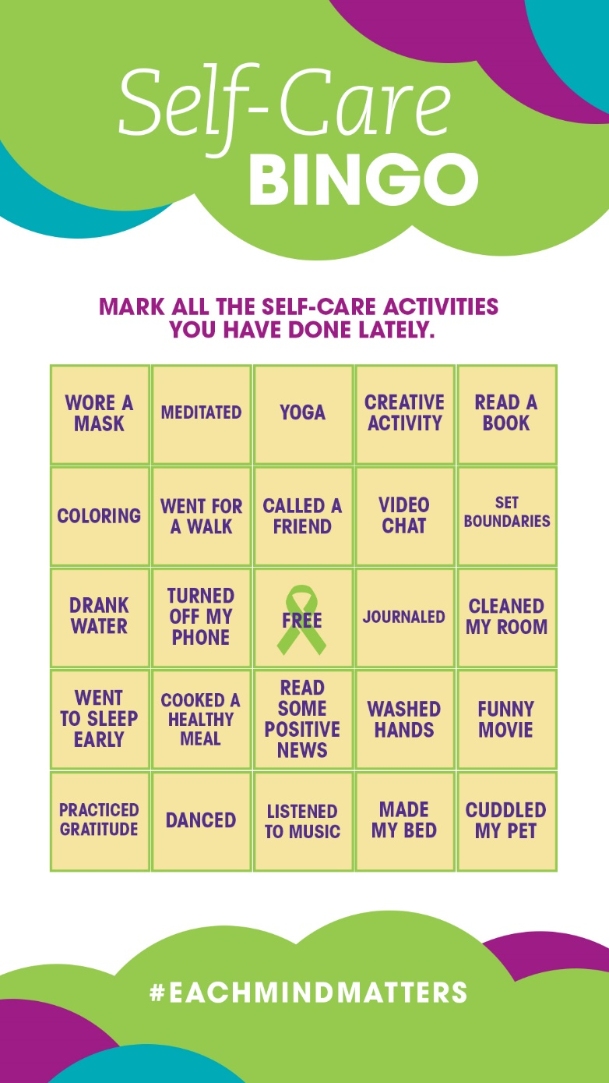
https://emmresourcecenter.org/resources/may-mental-health-matters-month-2020-activation-toolkit
Notes:
Before we close, I would like to provide you some resources for this month of May, Mental Health Awareness Month.
As we celebrate May Mental Health Matters Month, we are focusing on how expressing ourselves in different ways can raise awareness about mental health, break down barriers between people, build our own wellness and strengthen our communities.
I’ve included the link to all of California’s Each Mind Matters free items in the 2020 activation kit, including files to share via email, social media and by printing. You can also download the activation kit on the Each Mind Matters Resource Center. Most of the materials are in both English and Spanish, and many of them can be shared digitally.

Slide 21
https://www.mhanational.org/mental-health-month-2020-toolkit-download
Notes:
Mental Health America’s May Mental Health Month toolkit this year focuses on resiliency, offering tools to thrive at any time. These tools – even those that we all may have to adapt for the short term because of social distancing – will be more useful than ever. There is bonus material in the toolkit specifically focused on the coronavirus, and how we can all work together to support our mental health in the face of uncertainty.
This year’s toolkit includes Drop-In Articles, a May is Mental Health Month Proclamation, Shareable Images for Facebook, Twitter, and Instagram , call to Action Buttons for free mental health screenings, printable handouts such as Creating Healthy Routines • Supporting Others • Connecting with Others, and other outreach materials for youth, families, and staff. The link for this free download of materials is included on the slide. I’ve included a copy of the Creating Healthy Routines in our resource folder; feel free to use this worksheet with your students or family.
Please take our 3rd poll so CASP can know how to support you professionally in the future.

Slide 22
Susan K. Coats, Ed.D, School Psychologist, LEP #2836
Contact: coatslep@gmail.com
Thomas J. Sopp, MA, School Psychologist, LMFT #36146
Contact: TSopp@lbschools.net

